Slide 1



Artificial Intelligence Essentials for Business Leaders
Knowledge Talk on
Bhagirath Kumar Lader
Date: 29th May 2020
11:20 AM

Slide 2
Motivation
Analytics Journey
Breaking the Analytics Wall
Artificial Intelligence Essentials
Machine Learning
Deep Learning
AI Hype vs Reality
Business Applications
Agenda
2 | 50

Slide 3
A Motivation for
Analytics
&
Artificial Intelligence

Slide 4

The Need for Artificial Intelligence

Slide 5
Early Analytics
1880 | US Census Bureau | 7 Years for Report
1890 | Herman Hollerith | Tabulating Machine | 1 ½ Years for Report
Frederick Winslow Taylor | time management exercises.
Henry Ford | the speed of assembly lines.
1960s | Computers | Decision-Support Systems | Analytics

Slide 6
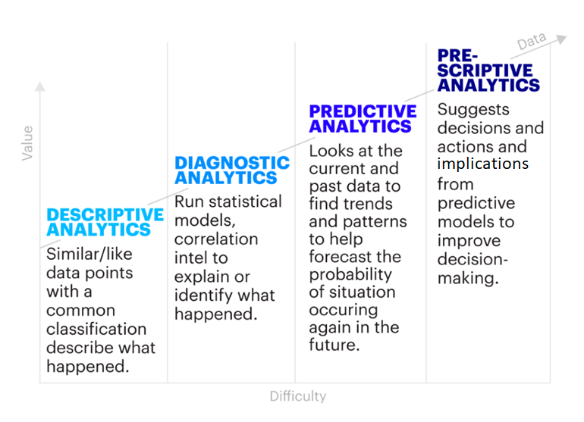
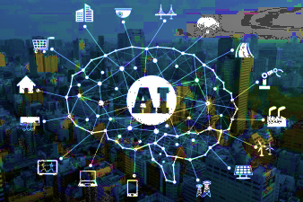
Analytics Journey - Modern
DECISION AUTOMATION
Artificial Intelligence
Machine Learning
Deep Learning
Evolutionary Algorithms
Notes:
https://www.accenture.com/us-en/blogs/blog-ruehle-detwiler-procurement-data-insights

Slide 7
Different Analytics Domain in Business
Business Analytics
Marketing Analytics
Customer Analytics
Operations Analytics
Supply Chain Analytics
Accounting Analytics
People Analytics
Notes:
https://www.hierarchystructure.com/business-strategy-hierarchy/

Slide 8
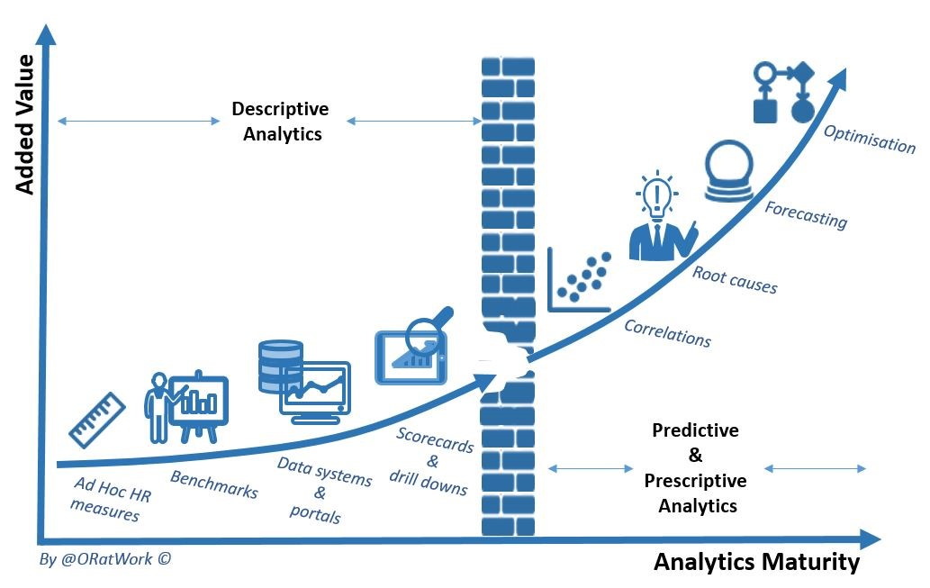

Wall in Analytics
Notes:
https://john-poppelaars.blogspot.com/2015/08/hr-analytics-breaking-through-wall-in.html

Slide 9









Some Leading Analytics Tools

Slide 10
Artificial Intelligence
Essentials for Business Professionals

Slide 11
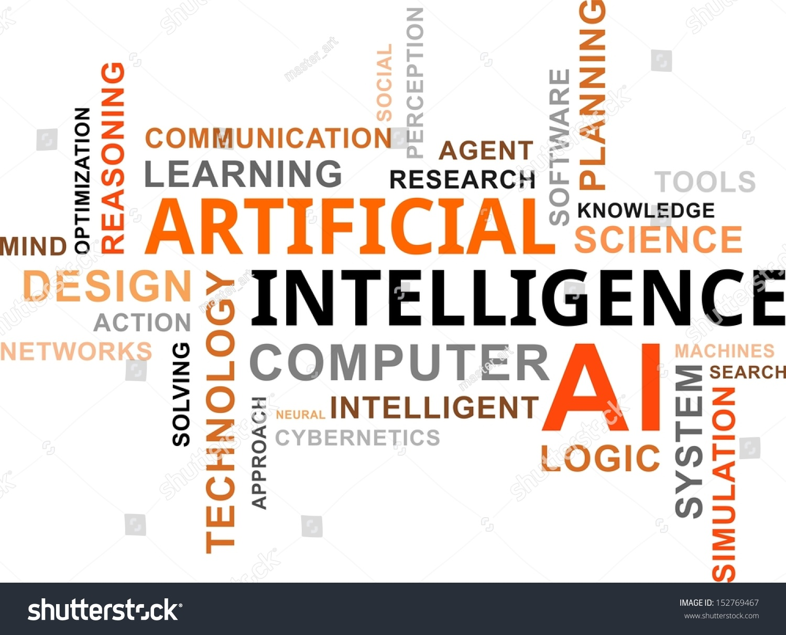
What Thoughts or Terms we Associate with Artificial Intelligence?
AI
Word-Cloud
Notes:
https://www.forbes.com/sites/louiscolumbus/2019/03/27/roundup-of-machine-learning-forecasts-and-market-estimates-2019/#75b5816c7695

Slide 12
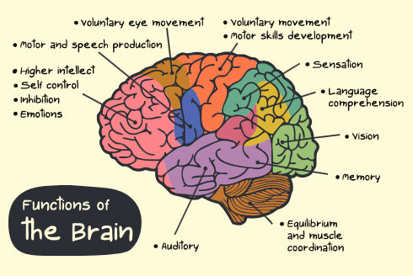
Cognitive Ability
Cognitive ability is defined as a general mental capability involving
reasoning,
problem solving,
planning,
abstract thinking,
complex idea comprehension,
learning from experience
Intelligence is the measure of cognitive capabilities

Slide 13
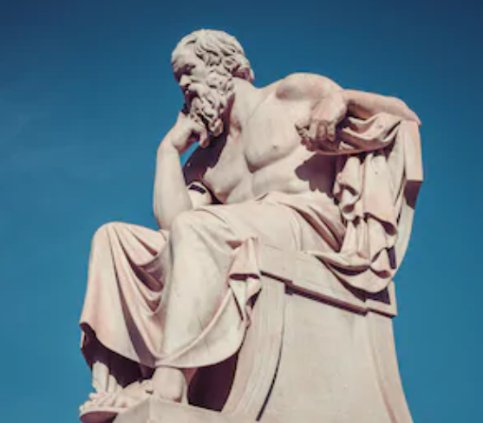
Artificial Intelligence
Prominent philosophers such as
Aristotle
St. Thomas Aquinas
William of Ockham
René Descartes
Thomas Hobbes, and
Gottfried W. Leibniz
have asked the questions:
“What are basic cognitive operations?”
“What necessary conditions should a (formal) language fulfill in order to be an adequate tool for describing the world in a precise and unambiguous way?”
“Can reasoning be automatized?”
“Is it possible to construct an artificial intelligence system?”

Slide 14
Artificial Intelligence
Artificial Intelligence or Machine Intelligence is a set of related technologies that seems to emulate human thinking and action in machines or agents
AI is about idea of building machines or agents which are capable of thinking and acting like humans
AI systems:
learn from experience i.e. data / feedback
arrive at their own conclusions
appear to understand complex real-world case or scenario
participate in natural-language dialogues with people
have cognitive capabilities i.e. learning and problem solving

Slide 15
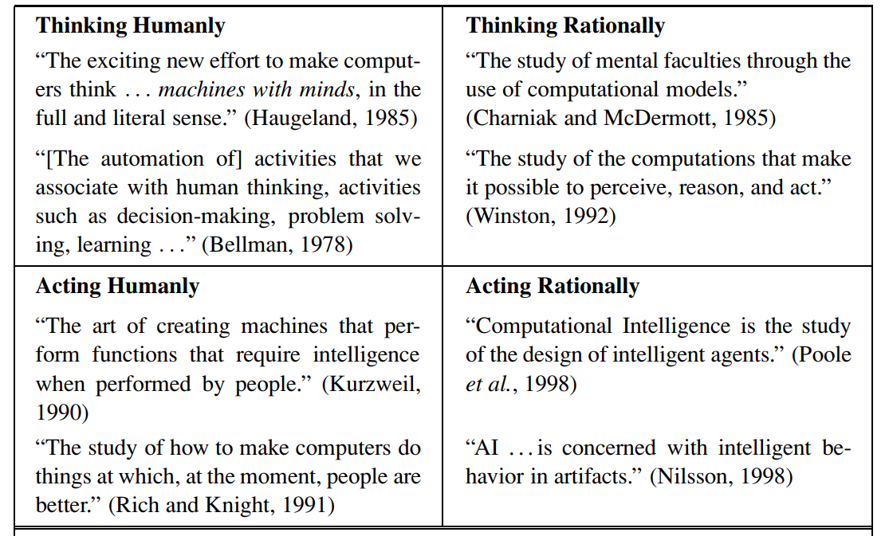
Some Definitions of AI – Four Categories
Artificial Intelligence –
A Modern Approach
Russel & Norvig

Slide 16
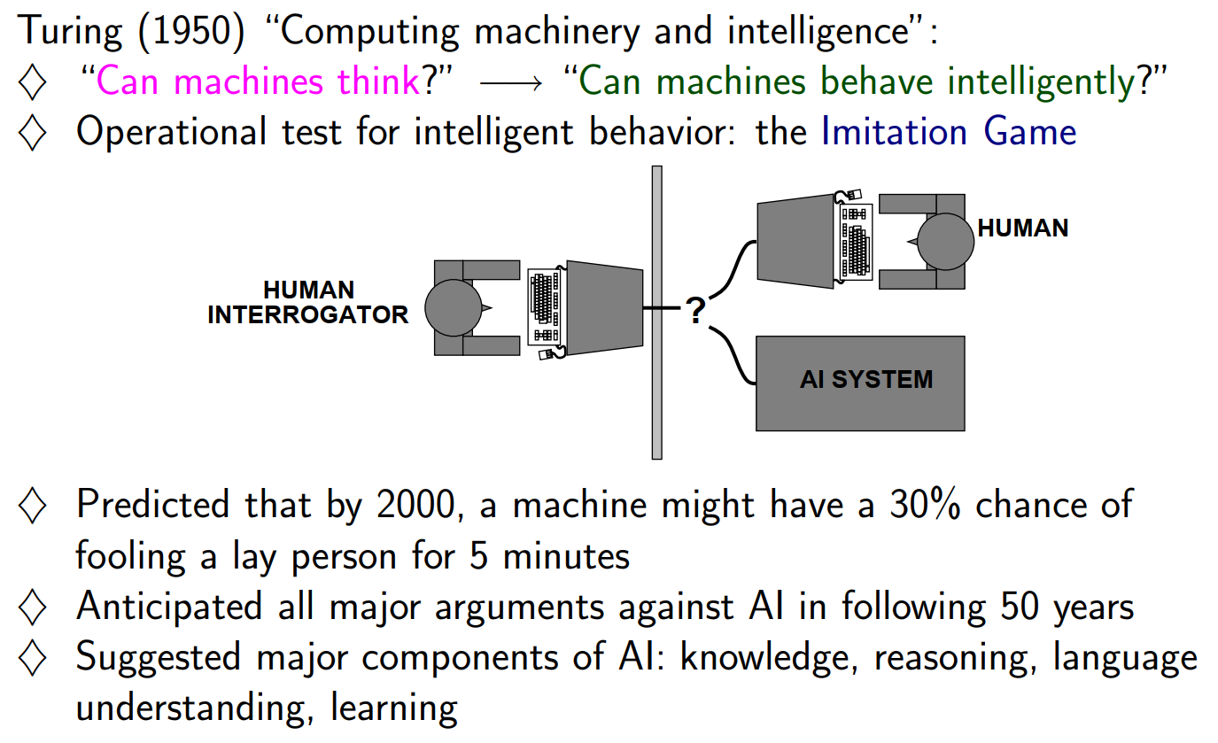
Acting Humanly – The Turing Test Approach
Artificial Intelligence –
A Modern Approach
Russel & Norvig

Slide 17
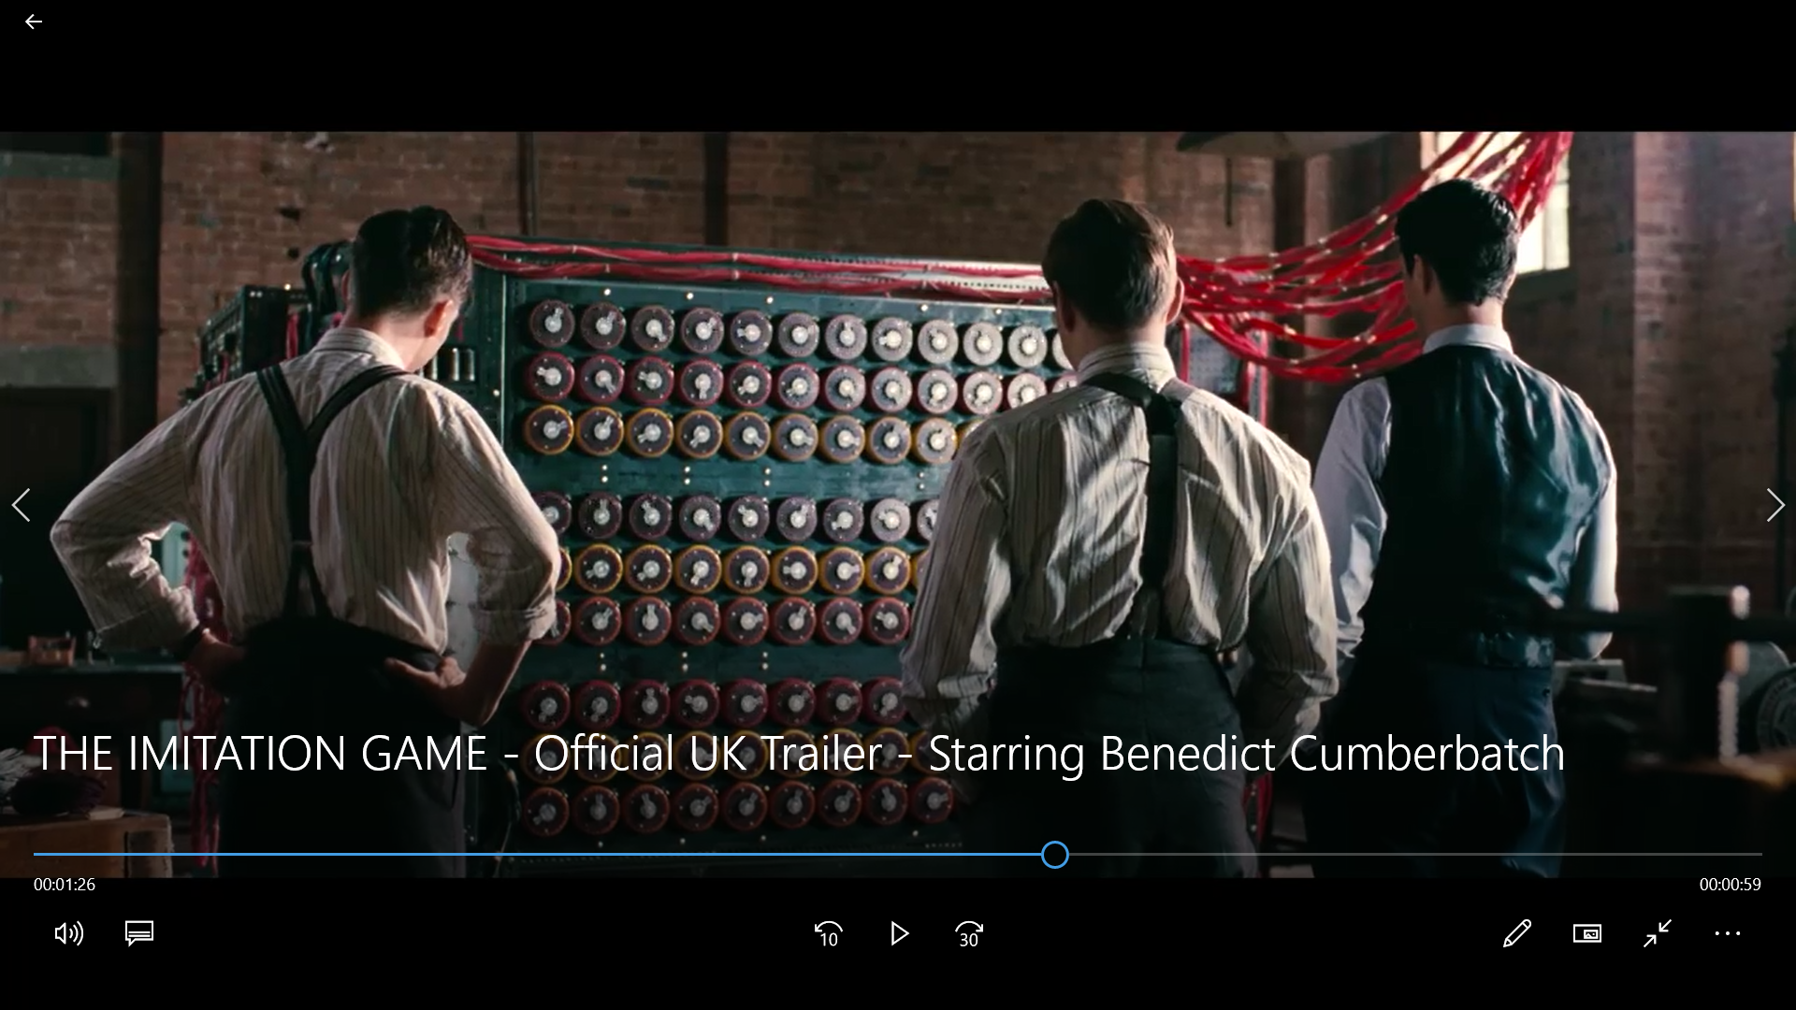
Enigma Video

Slide 18
Thinking Humanly – Cognitive Science Approach
If we are going to say that a given program thinks like a human, we must have some way of determining how humans think.
We need to get inside the actual workings of human minds.
Allen Newell and Herbert Simon, who developed GPS, the “General Problem Solver” (Newell and Simon, 1961), were not content merely to have their program solve problems correctly. They were more concerned with comparing the trace of its reasoning steps to traces of human subjects solving the same problems
Artificial Intelligence –
A Modern Approach
Russel & Norvig

Slide 19
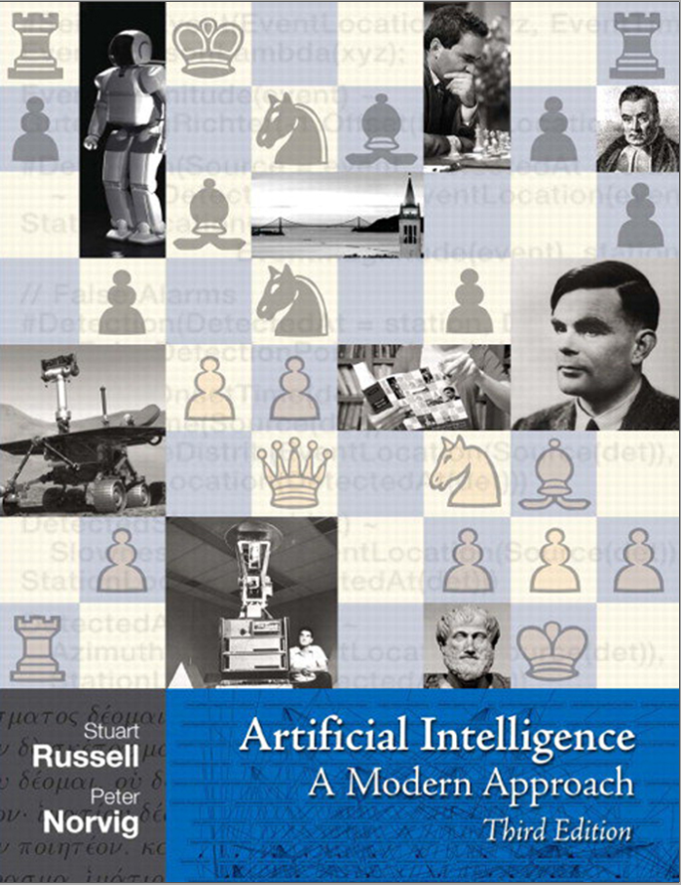
Artificial Intelligence
Rationality
A system is rational if it does the “right thing,” given what it knows.

Slide 20
Thinking RATIONALLY – Laws of Thought approach
Aristotle was one of the first to attempt to codify “right thinking,” that is, irrefutable reasoning processes.
His syllogisms provided patterns for argument structures that always yielded correct conclusions when given correct premises
By 1965, programs existed that could, in principle, solve any solvable problem described in logical notation.
The so-called logicist tradition within artificial intelligence hopes to build on such programs to create intelligent systems.
“Socrates is a man; all men are mortal; therefore, Socrates is mortal.”
Artificial Intelligence –
A Modern Approach
Russel & Norvig

Slide 21
Acting RATIONALLY – The Rational Agent approach
All computer programs do something, but computer agents are expected to do more:
operate autonomously,
perceive their environment,
persist over a prolonged time period,
adapt to change, and
create and pursue goals.
A rational agent is one that acts so as to achieve the best outcome or, when there is uncertainty, the best expected outcome.
Rational behavior is doing the right thing. The right thing is that which is expected to maximize goal achievement, given the available information
Artificial Intelligence –
A Modern Approach
Russel & Norvig

Slide 22
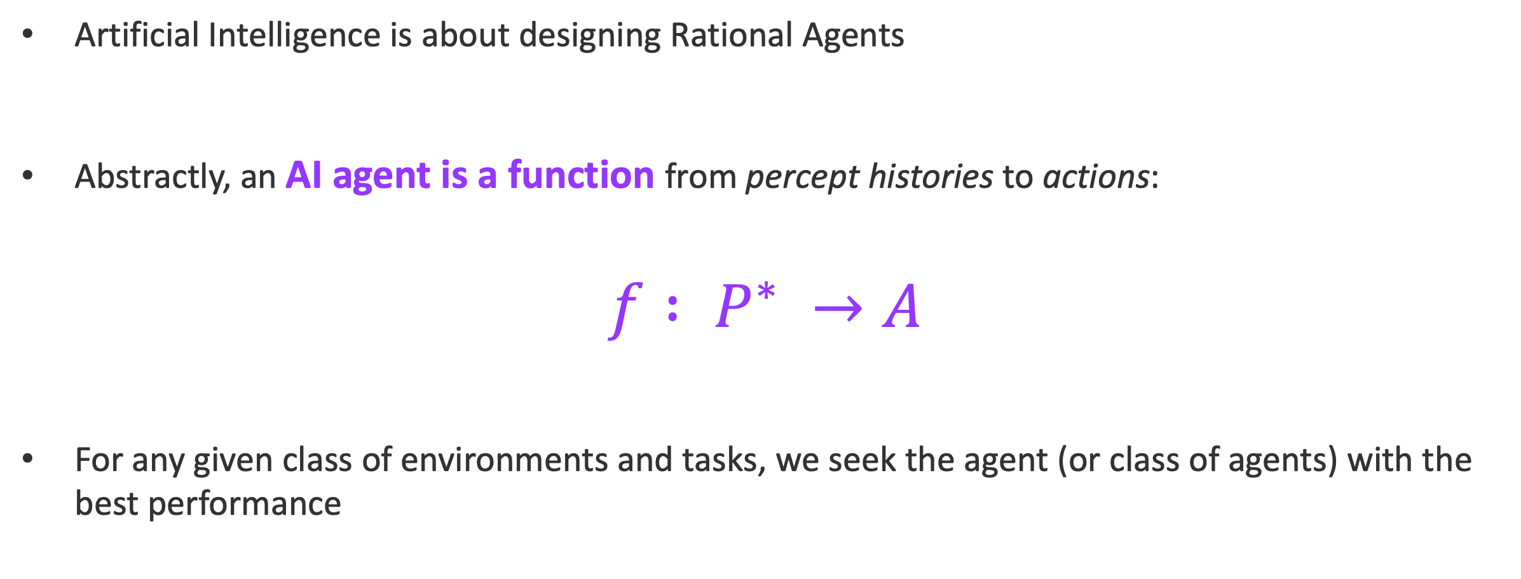
Rational Agent
Artificial Intelligence is about designing Rational Agents
Abstractly, an AI agent is a function from percept histories to actions:
$$f : P^{∗} →A$$
For any given class of environments and tasks, we seek the agent (or class of agents) with the best performance
Rational behavior is doing the right thing. The right thing is that which is expected to maximize goal achievement, given the available information
Artificial Intelligence –
A Modern Approach
Russel & Norvig

Slide 23
Goals of Artificial Intelligence
1
The Goals of AI is driven by two groups:
Industry, whether related to goods or services, is concerned primarily with creating expert systems
Expert Systems should demonstrate intelligent behavior, regardless of their resemblance or non-resemblance to human intelligence.
The systems which exhibit intelligent behavior, learn, demonstrate, explain, and advice its users.
2
Academia of Cognitive Science, rising out of psychology, linguistics, philosophy, biology, social sciences and computer science which is interested in AI for its ability to
Model Human Intelligence with aim to some day replicating or surpassing human level intelligence.
Creating systems that understand, think, learn, and behave like humans.
https://www.cs.swarthmore.edu/~eroberts/cs91/projects/ethics-of-ai/sec2.html

Slide 24
History of Artificial Intelligence
Year | Milestone / Innovation
1923 | Karel Čapek play named “Rossum's Universal Robots” (RUR) opens in London, first use of the word "robot" in English.
1943 | Foundations for neural networks laid.
1945 | Isaac Asimov, a Columbia University alumni, coined the term Robotics.
1950 | Alan Turing introduced Turing Test for evaluation of intelligence and published Computing Machinery and Intelligence. Claude Shannon published Detailed Analysis of Chess Playing as a search.
1955 | The first AI system, called Logic Theorist, was designed by Allen Newell and Herbert Simon and implemented by J. Clifford Shaw at CMU
Source:
TutorialPoint

Slide 25
History of Artificial Intelligence
Year | Milestone / Innovation
1956 | John McCarthy coined the term Artificial Intelligence.
1958 | John McCarthy invents LISP programming language for AI.
1964 | Computers can understand natural language well enough to solve algebra word problems correctly.
1965 | Joseph Weizenbaum at MIT built ELIZA, the first chatbot
1969 | Shakey, a robot, by Stanford Scientists equipped with locomotion, perception, and problem solving.
1973 | Edinburgh University built Freddy, the Famous Scottish Robot, capable of using vision to locate and assemble models.
Source:
TutorialPoint

Slide 26
History of ai
Year | Milestone / Innovation
1979 | The first computer-controlled autonomous vehicle: Stanford Cart
1985 | Harold Cohen created and demonstrated the drawing program, Aaron.
1990 | Major advances in all areas of AI − Case-based reasoning Multi-agent planning Scheduling Data mining, Web Crawler natural language understanding and translation Vision, Virtual Reality Games
Source:
TutorialPoint

Slide 27

History of Artificial Intelligence
Year | Milestone / Innovation
1997 | The Deep Blue Chess Program beats the then world chess champion, Garry Kasparov.
2000 | MIT displays Kismet, a robot with a face that expresses emotions. The robot Nomad explores remote regions of Antarctica and locates meteorites.
2011 | IBM Watson AI beats human in Jeopardy
2016 | DeepMind’s AlphaGo AI beats human in Go
2019 | Facebook and CMU’s AI poker bot is first to beat professionals at multiplayer game
2019 AI Poker Triumph
Source:
TutorialPoint and Nature Journal

Slide 28
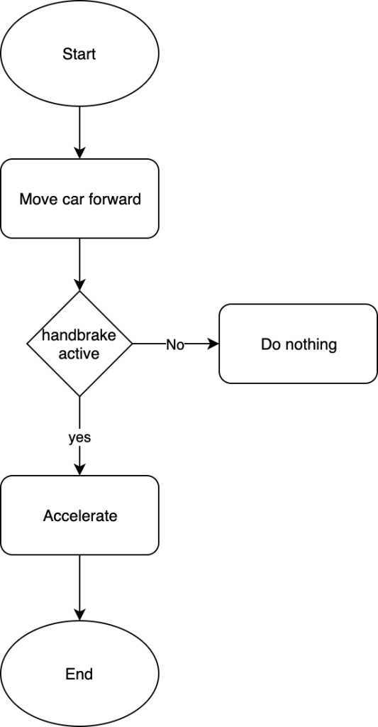
Artificial Intelligence Paradigms
Symbolic Artificial Intelligence View
The field of AI, since its inception, has been conceived mainly as the development of models using symbol manipulation.
The computation in such models is based on explicit representations that contain symbols organized in some specific ways
The aggregate information are constructed from constituent symbols and syntactic combinations of these symbols.
Also called Good Old-Fashioned AI (GOFAI)
A physical symbol system has the necessary and sufficient means for general intelligent action.
-Newell and Simon, 1976
Notes:
https://bdtechtalks.com/2019/11/18/what-is-symbolic-artificial-intelligence/
We use symbols all the time to define things (cat, car, airplane, etc.) and people (teacher, police, salesperson). Symbols can represent abstract concepts (bank transaction) or things that don’t physically exist (web page, blog post, etc.). They can also describe actions (running) or states (inactive). Symbols can be organized into hierarchies (a car is made of doors, windows, tires, seats, etc.). They can also be used to describe other symbols (a cat with fluffy ears, a red carpet, etc.).
Being able to communicate in symbols is one of the main things that make us intelligent. Therefore, symbols have also played a crucial role in the creation of artificial intelligence.
“A physical symbol system consists of a set of elements called symbols that are used by the system to construct symbolic structures called expressions and a set of processes for their modification, reproduction, and destruction. In other words, the system transforms a certain set of expressions.”
Introduction to Artificial Intelligence, Mariusz Flasinski

Slide 29
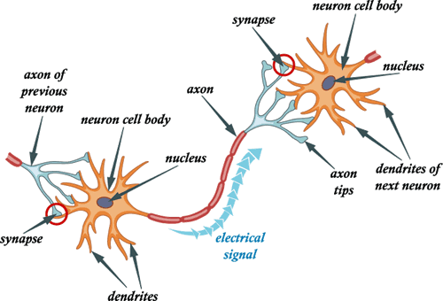
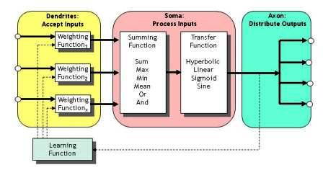
Artificial Intelligence Paradigms
Connectionists View
Inspired by human brain
A large number of simple and uniform processing elements (neurons) interconnected with extensive links
Due to their massively parallel nature, such models are good at flexible and robust processing
Image Credit: http://www.mysearch.org.uk/website1/html/106.Connectionist.html
Notes:
http://www.mysearch.org.uk/website1/html/106.Connectionist.html

Slide 30
AI Knowledge Domains
Mathematics
Linguistics
Logic
Engineering
Cognitive Science
Statistics
Ethics
Natural Sciences
Computer Science
Physiology
Philosophy
Psychology

Slide 31

AI Technological Representations
Machine Learning
Robotics
Search
Fuzzy Logic
Expert Systems
NLP

Slide 32


Types of Artificial Intelligence
Weak AI or Narrow AI
AI system that is designed and trained for a particular task which it can do at par or better than a human.
Virtual personal assistants, such as Apple's Siri or Google Assistant, are a form of weak AI.

Slide 33

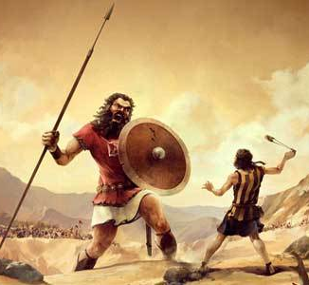
Types of Artificial Intelligence
Artificial General Intelligence
An artificial intelligence reaches the general state when it can perform any intellectual task with the same accuracy level as a human would.
Strong Artificial Intelligence
Strong Artificial Intelligence is a theoretical form of machine intelligence that is equal to human intelligence.
In some sense, strong AI would share same characteristics as general AI.
Notes:
Cognitive science is a new interdisciplinary research field on mind and cognitive
processes concerning not only humans, but also artificial systems. Its research
focuses on issues which belong to philosophy, psychology, linguistics, neuroscience,
computer science, logic, etc.
In the first chapter we have discussed the Chinese room thought experiment, which
was introduced by Searle [269]. On the basis of this experiment views concerning
artificial intelligence can be divided into the following two groups:
• Strong Artificial Intelligence, which claims that a properly programmed computer
is equivalent to a human brain and its mental activity,
• Weak Artificial Intelligence, in which a computer is treated as a device that can
simulate the performance of a brain. In this approach a computer is also treated as
a convenient tool for testing hypotheses concerning brain and mental processes.
According to Searle the Chinese room shows that simulation of human mental activity
with the help of a computer (Weak AI) does not mean that these activities take place
in a computer in the same way as they do in a human brain. In other words, the
brain is not a computer, and computing processes performed according to computer
programs should not be treated as equivalent to mental processes in a human brain.
The term computationalism is related to Strong AI.

Slide 34
Machine Learning
Machine learning (ML) is a category of algorithms that allows software applications to become more accurate in predicting outcomes without being explicitly programmed.
The term was pioneered by Arthur Samuel of IBM in 1959.
Machine learning is the training of a model from data that generalizes a decision against a performance measure.
A computer program is said to learn from experience E with respect to some class of tasks T and performance measure P if its performance at tasks in T, as measured by P, improves with experience E.
(Tom M Mitchell)

Slide 35
Machine Learning
Can Machine Learn Anything?
We will need additionally a notion of sample complexity to evaluate the sample size required for the algorithm to learn a family of concepts.
More generally, theoretical learning guarantees for an algorithm depend on the complexity of the concept classes (mapping functions) considered and the size of the training sample.

Slide 36

Machine Learning Terminologies
Dataset
Records
Features
Labels
Training Set
Validation Set
Test Set
Loss Function
Optimization Method
Regularization
Hypothesis Set

Slide 37
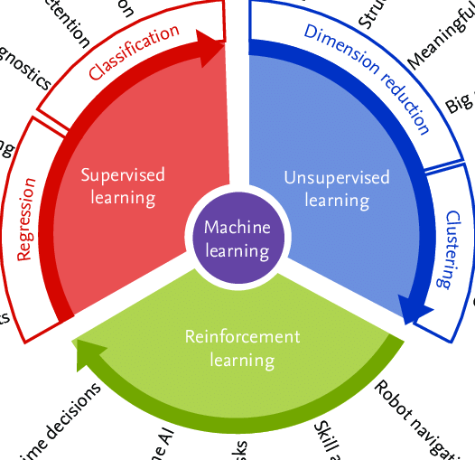
Types of Machine Learning
Supervised Learning
Unsupervised Learning
Reinforcement Learning

Slide 38
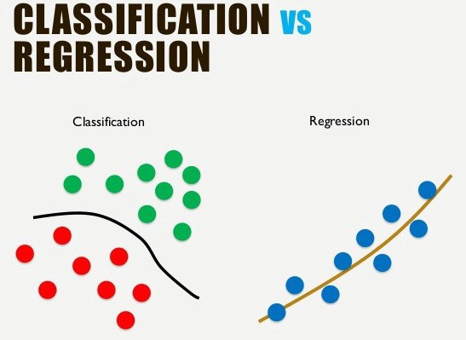
Supervised Learning
Supervised Learning Algorithms examples are linear and logistic regression, multi-class classification, Neural networks, and support vector machines etc.
Supervised learning classified into two categories of algorithms:
Classification: A classification problem is when the output variable is a category, such as “Red” or “Blue” or “spam” and “not spam”.
Prediction/Regression: A regression problem is when the output variable is a real value, such as “Rupees” or “weight”.

Slide 39
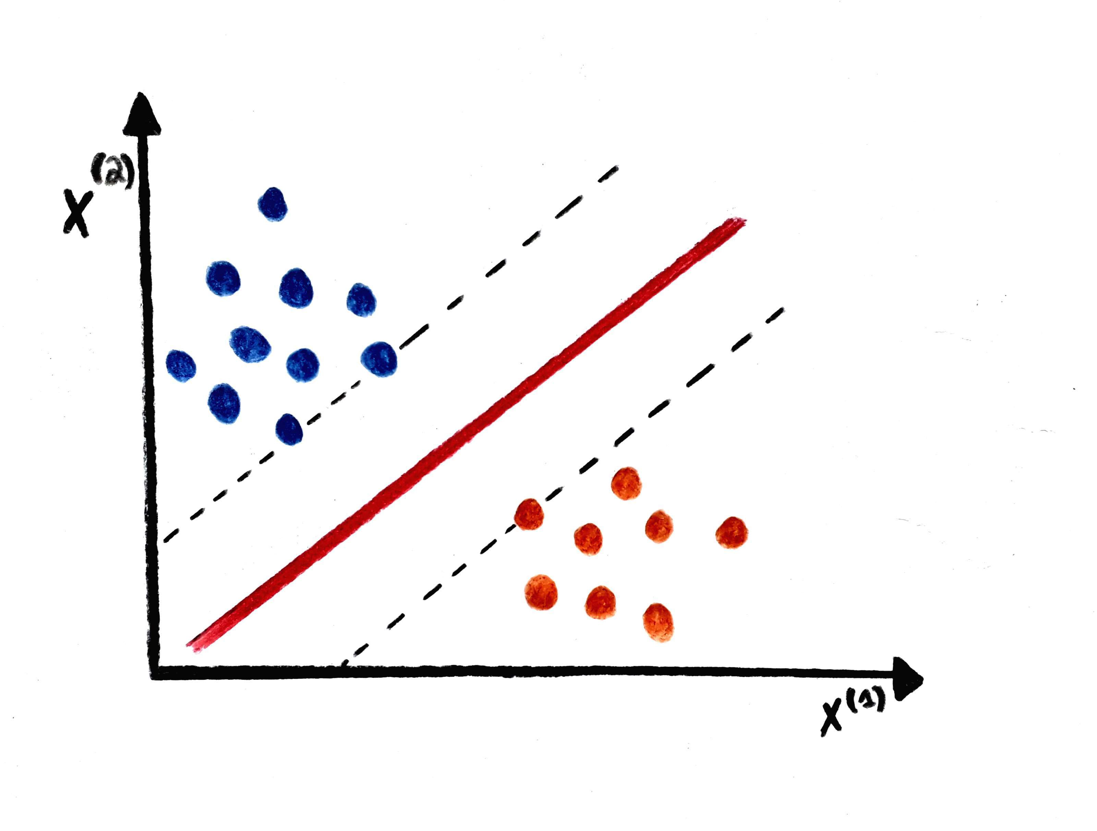
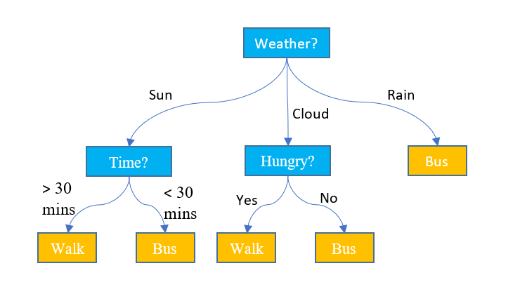
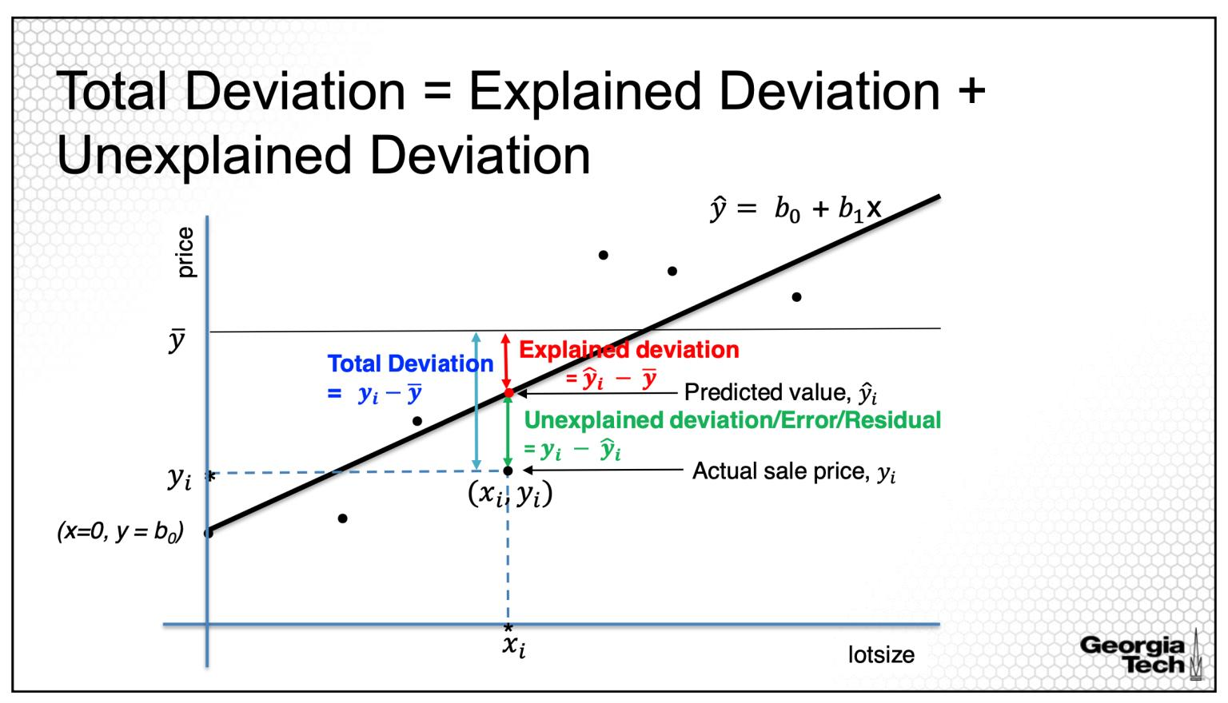
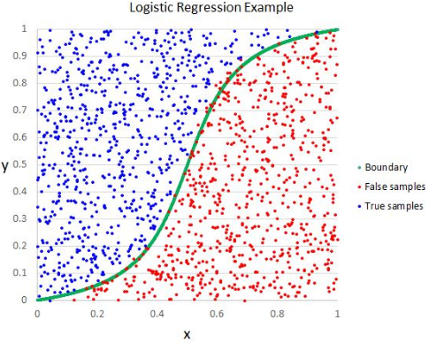
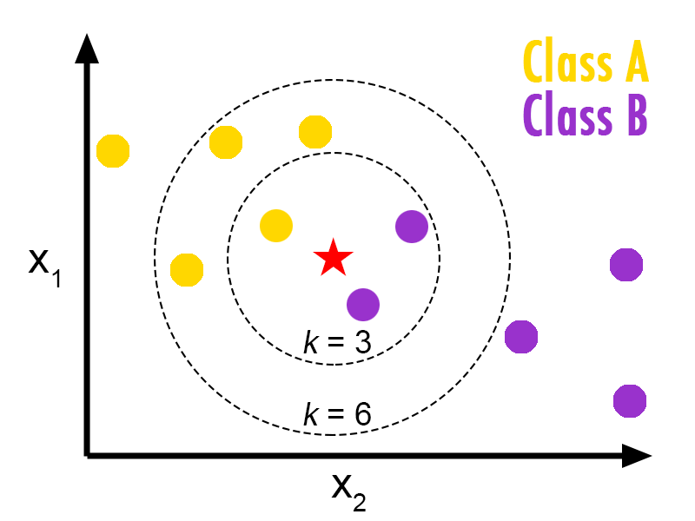
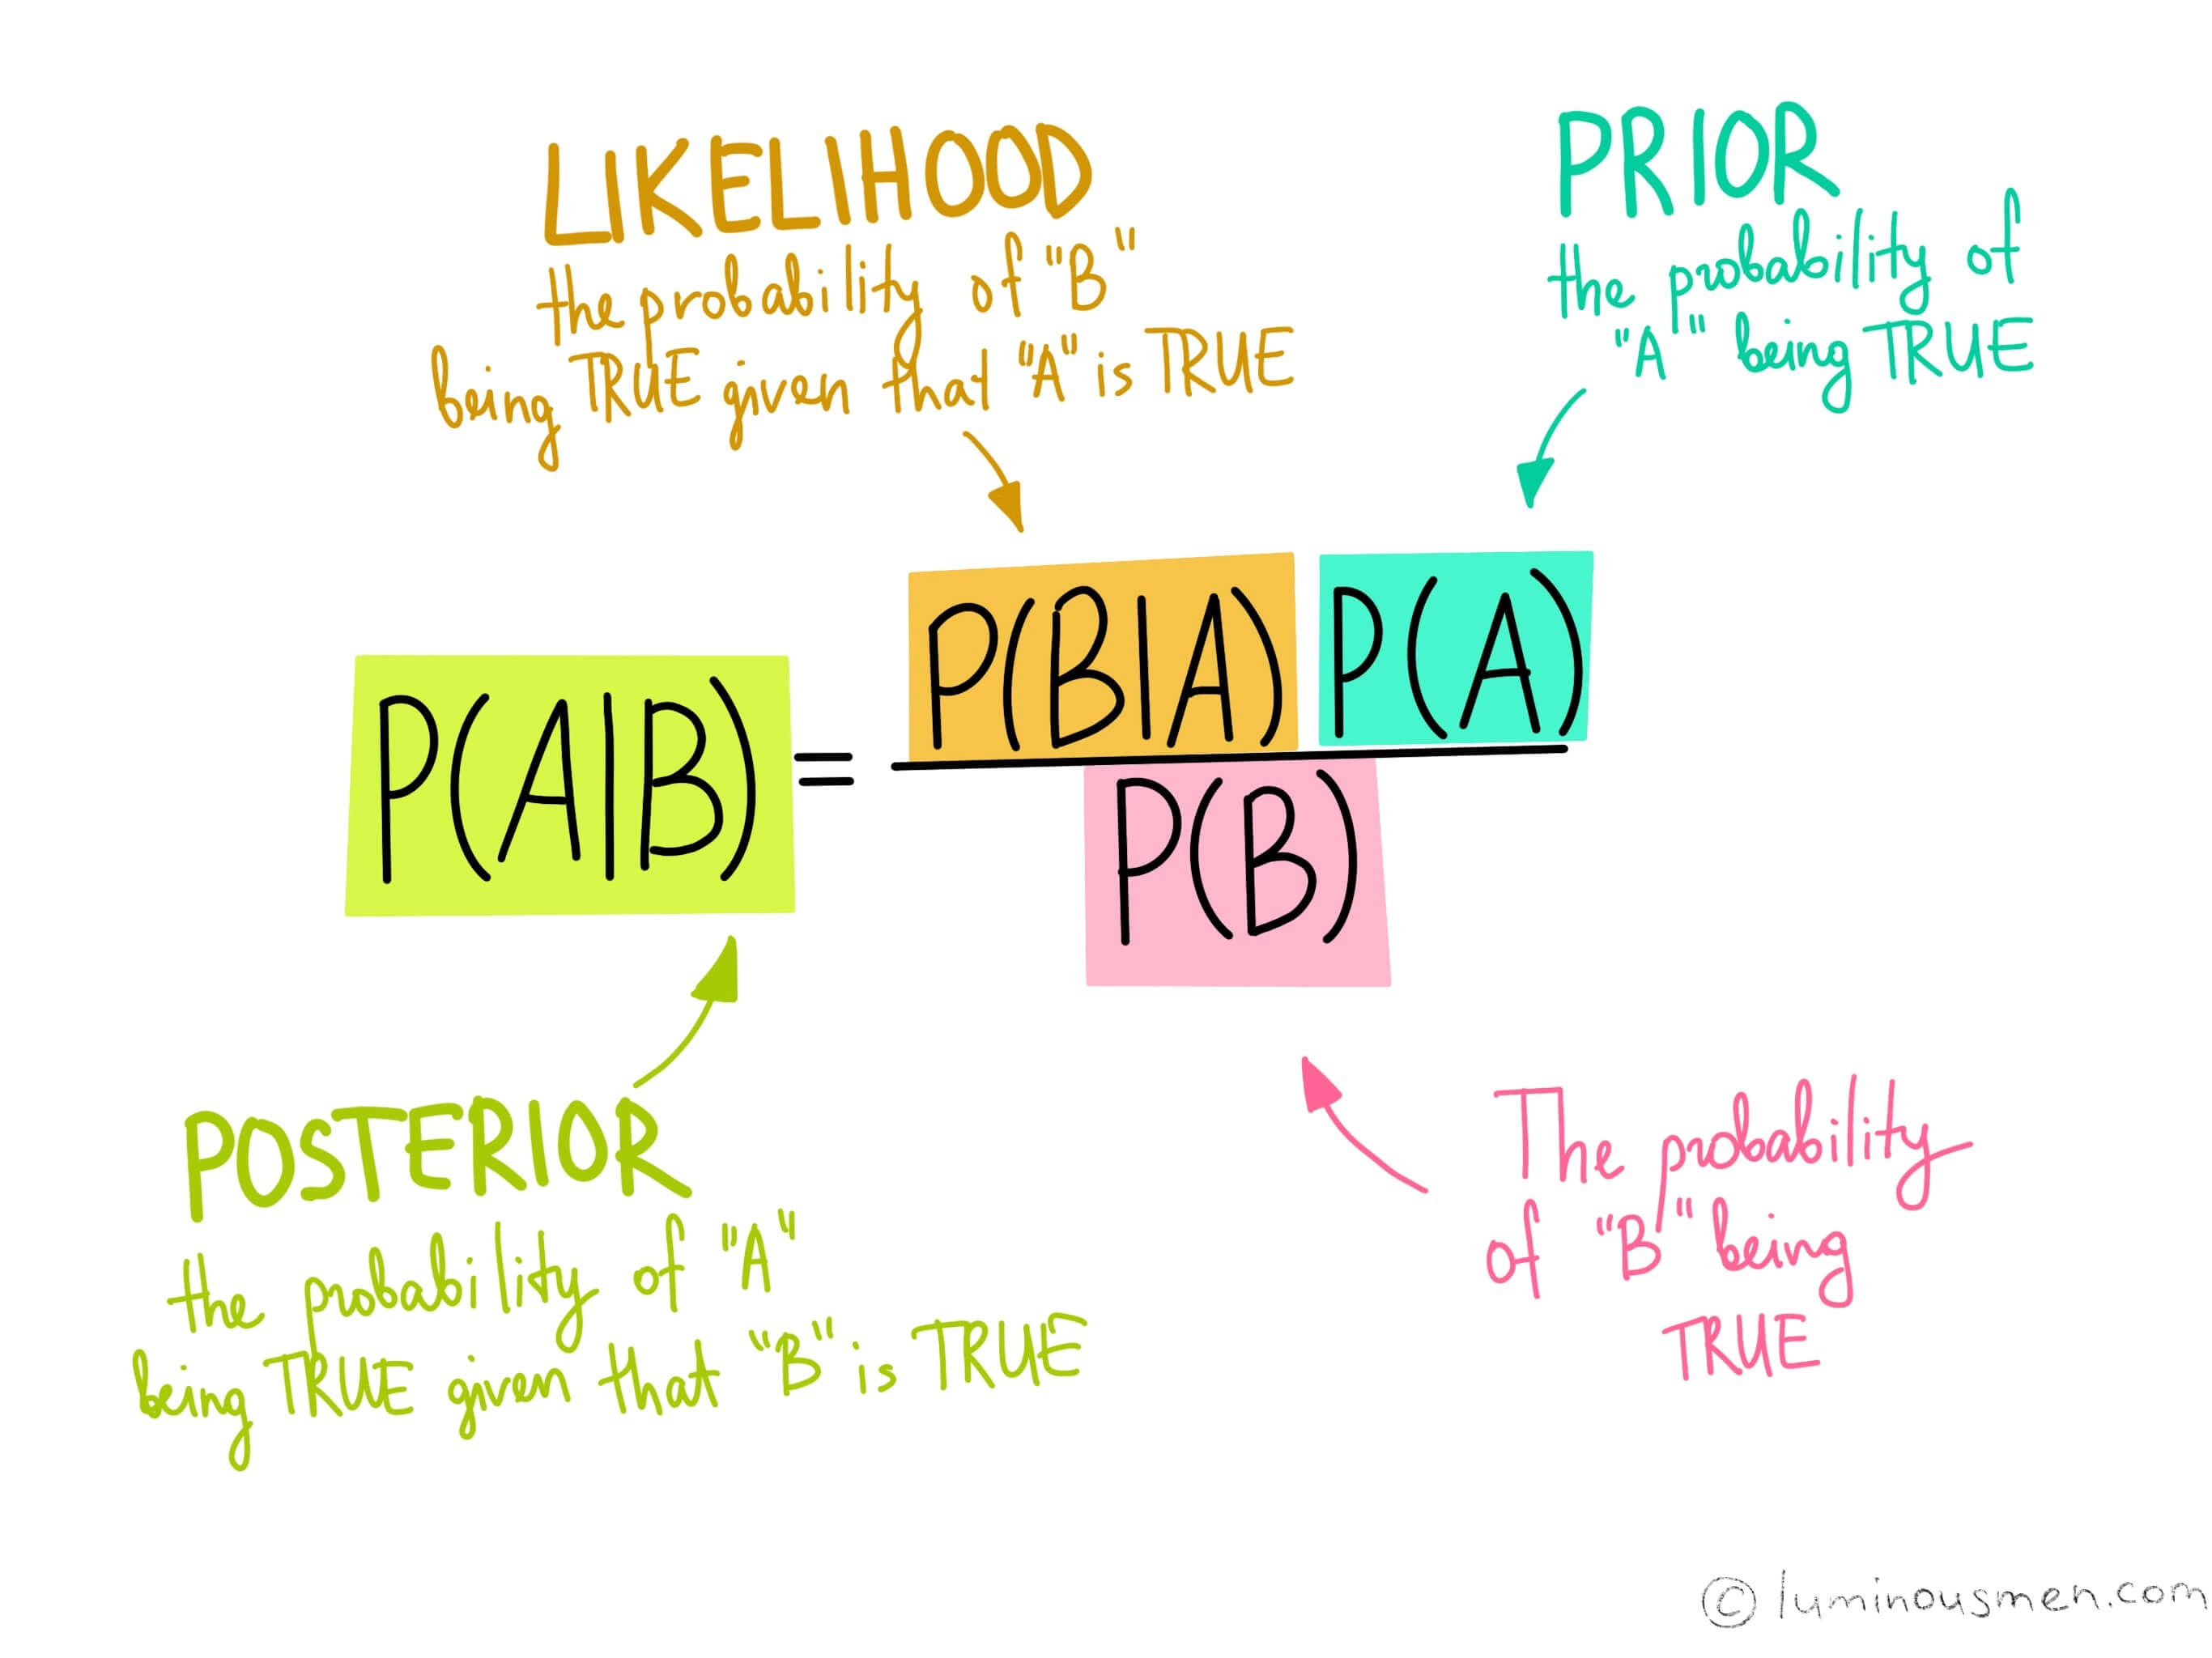
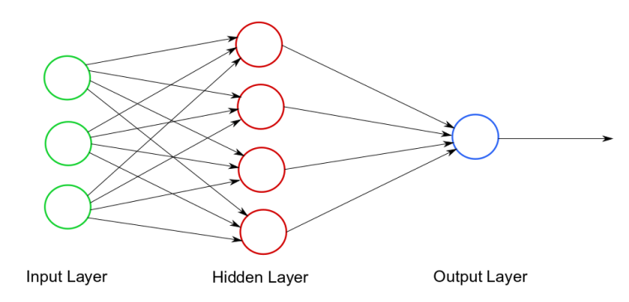
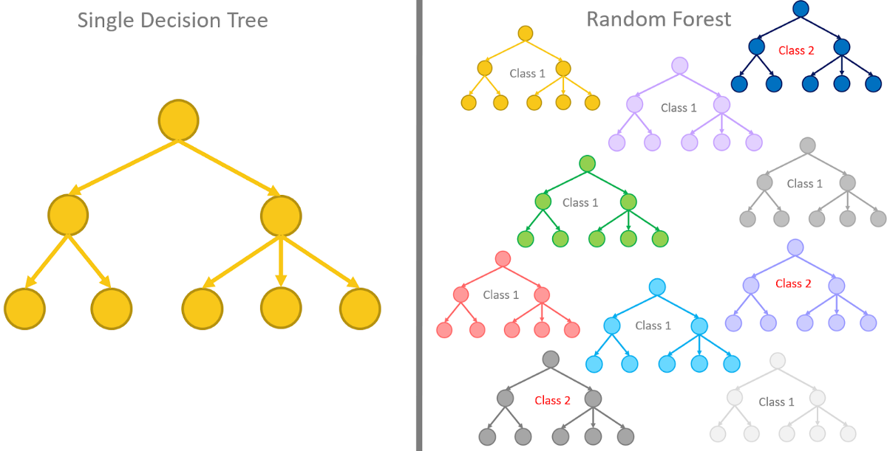
Supervised Learning – Some Common Algorithms
Linear Regression
Logistic Regression
Support Vector Machine
Decision Tree
K-Nearest Neighbour
Naïve Bayes Classifier
Neural Network
Random Forest

Slide 40
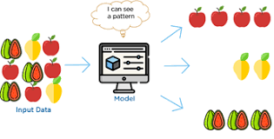
Unsupervised Learning
Unsupervised Learning is a class of Machine Learning techniques to find the patterns in data without any label.
Unsupervised learning is a type of machine learning algorithm used to draw inferences from datasets consisting of input data without labeled responses.
The most common unsupervised learning method is cluster analysis, which is used for exploratory data analysis to find hidden patterns or grouping in data.

Slide 41
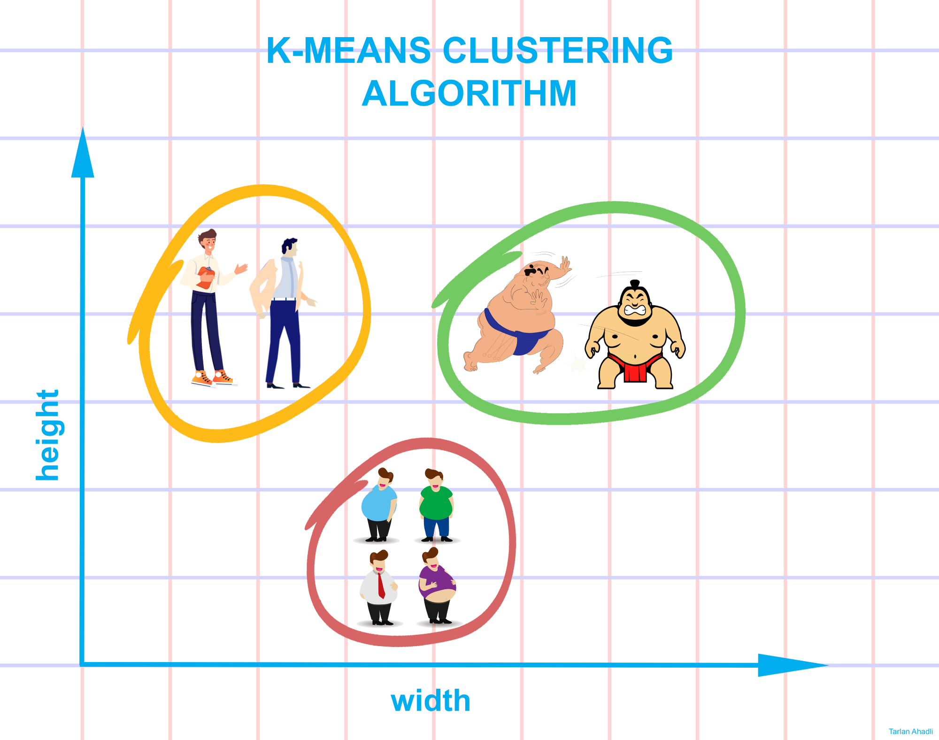
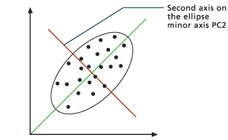
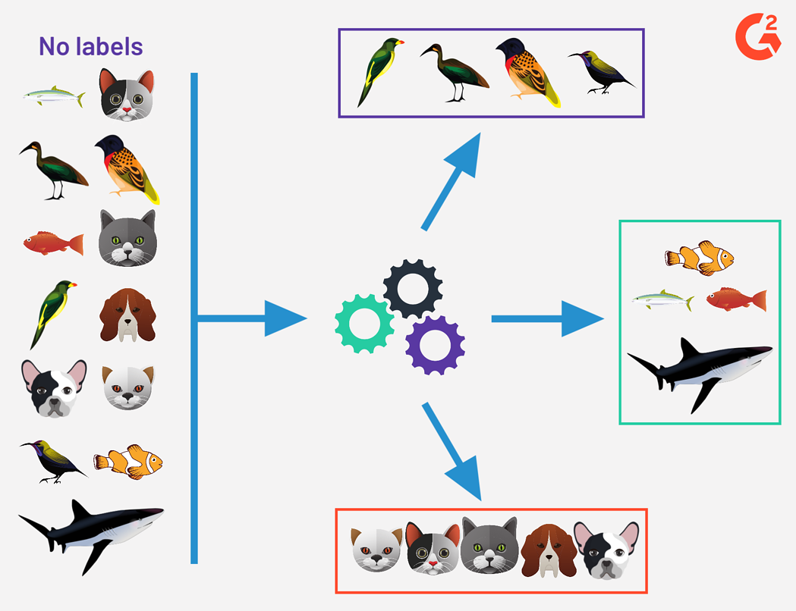
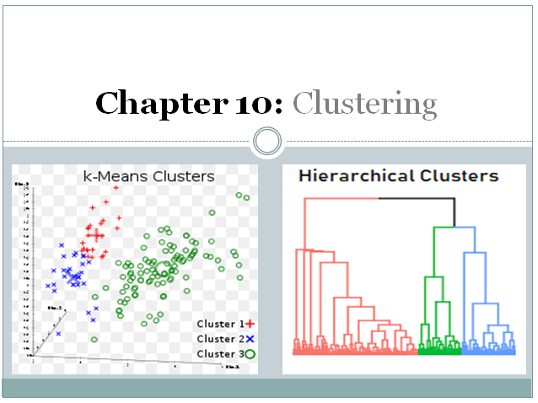
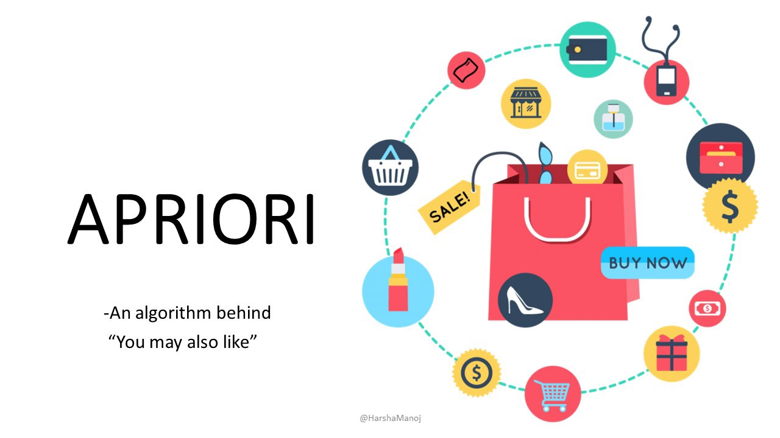
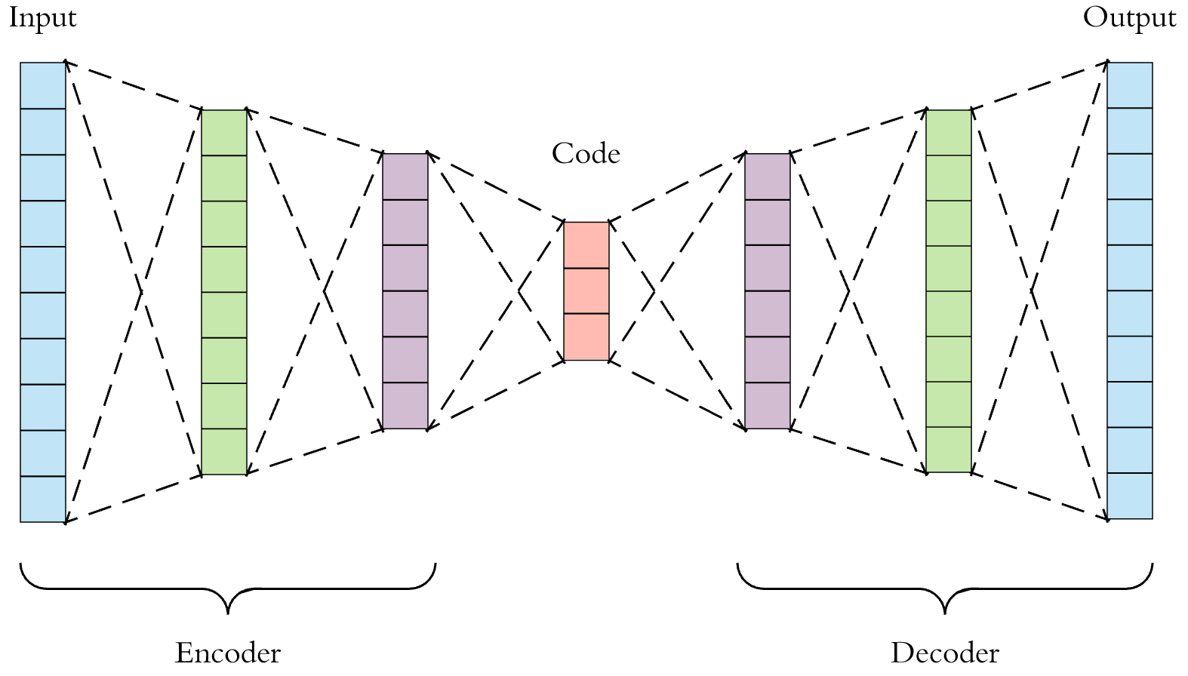
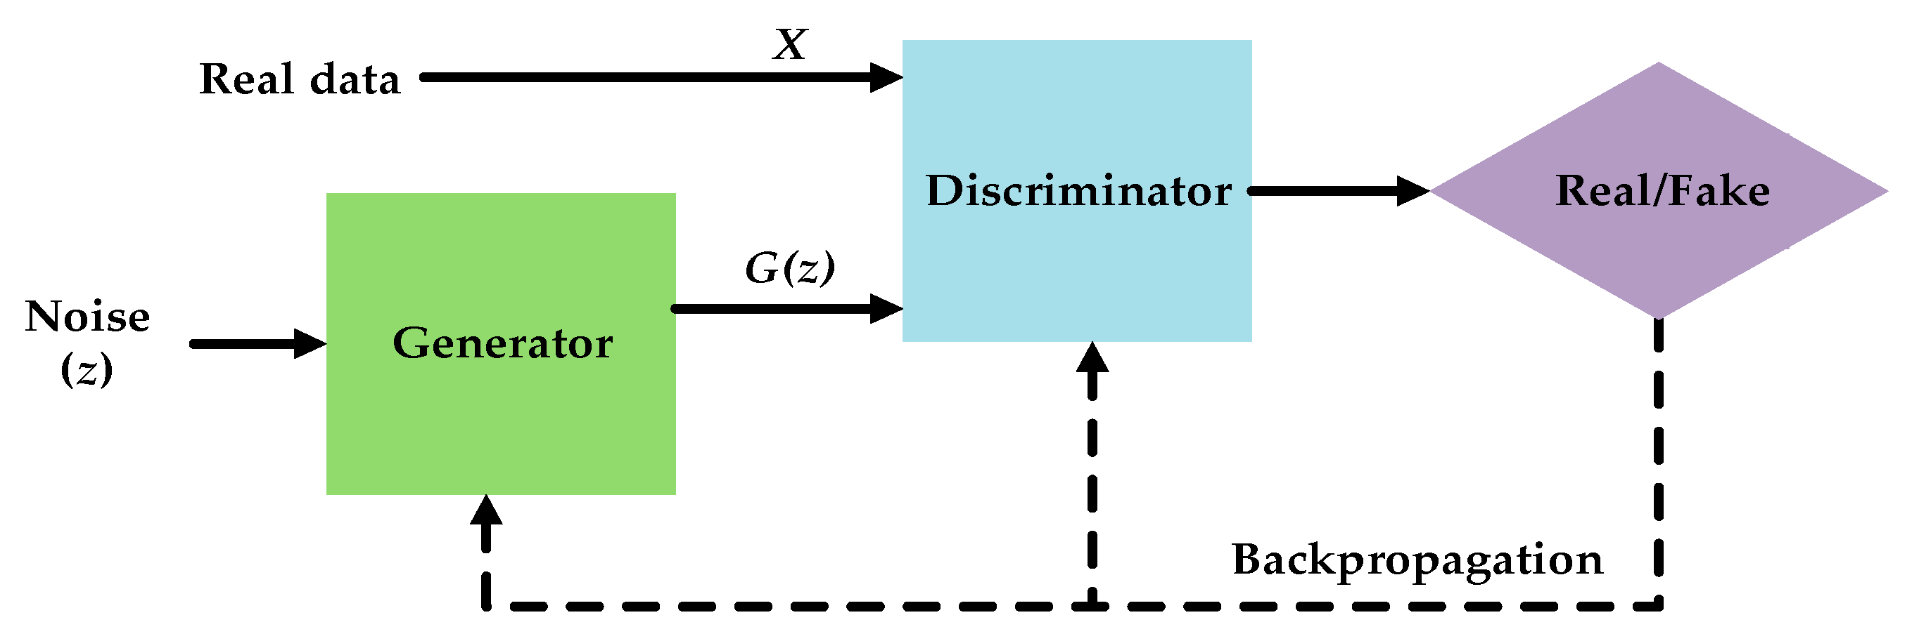
Unsupervised Learning – Common Algorithms
K-Means Clustering
Principal Component Analysis
Hierarchical Clustering
Apriori Algorithm for Association
Autoencoder
Generative Adversarial Networks
Notes:
https://machinelearningmastery.com/a-tour-of-machine-learning-algorithms/

Slide 42
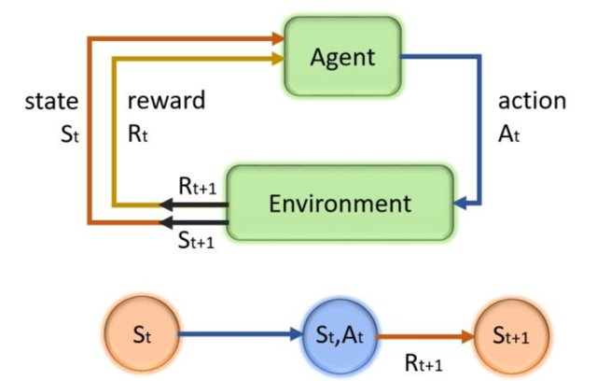
Reinforcement Learning
Reinforcement learning is about taking suitable action to maximize the expected reward in a particular situation
The reinforcement agent decides what to do to perform the given task
In the absence of training dataset, it is bound to learn from its experience

Slide 43
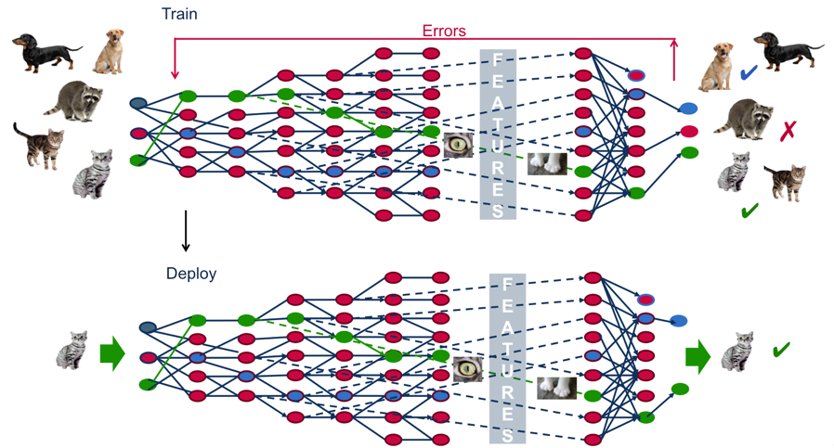
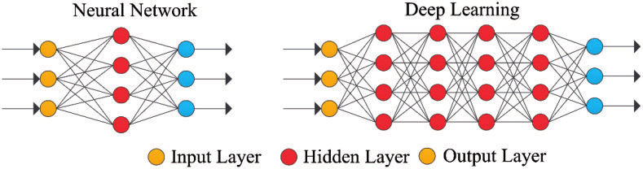
Deep Learning
Deep learning is part of a broader family of machine learning methods based on artificial neural networks with representation learning. Learning can be supervised, semi-supervised or unsupervised.
A Graph with depth more than 2
Notes:
https://mapr.com/blog/demystifying-ai-ml-dl/

Slide 44

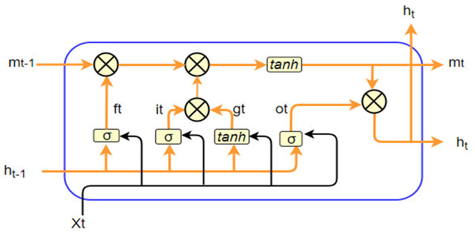

Deep Learning – Common Algorithms
Convolutional Neural Network for Computer Vision Tasks like Image Recognition
Recurrent Neural Network for Sequence Tasks like NLP
Neural Network for Any Deep Learning Task
Notes:
https://mapr.com/blog/demystifying-ai-ml-dl/

Slide 45
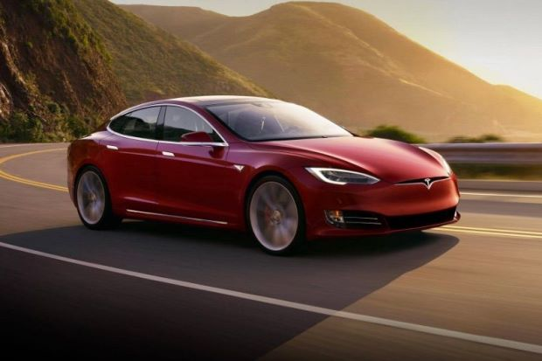
Reinforcement Learning
Video Link- Tesla Auto Pilot

Slide 46




Leading Cloud AI Platforms
Oracle AI
Salesforce
Baidu
Pega
Infosys Nia
Wipro HOLMES
API.AI
Premonition
Rainbird

Slide 47
Artificial Intelligence
Hype Vs Reality

Slide 48
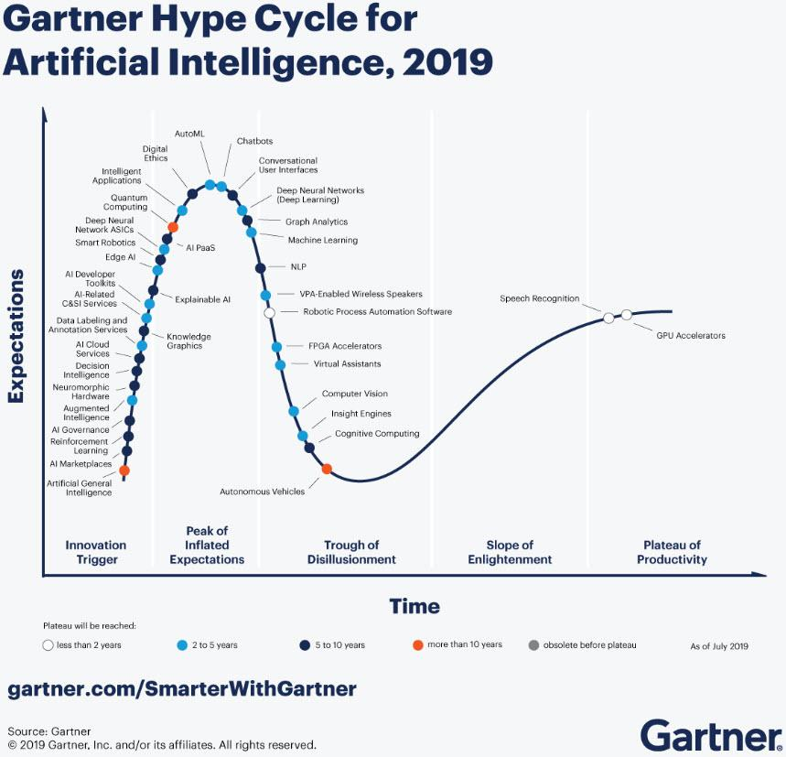
AI Hype Cycle by Gartner
The key take-aways from this hype-cycle is that
Machine learning and Deep Learning have crossed their peak of inflated expectation.
Machine Learning and Deep Learning will reach the plateau of productivity in next 2 to 5 years i.e. between 2021 to 2024.

Slide 49
Artificial Intelligence
AI Projected Impact on Industries

Slide 50
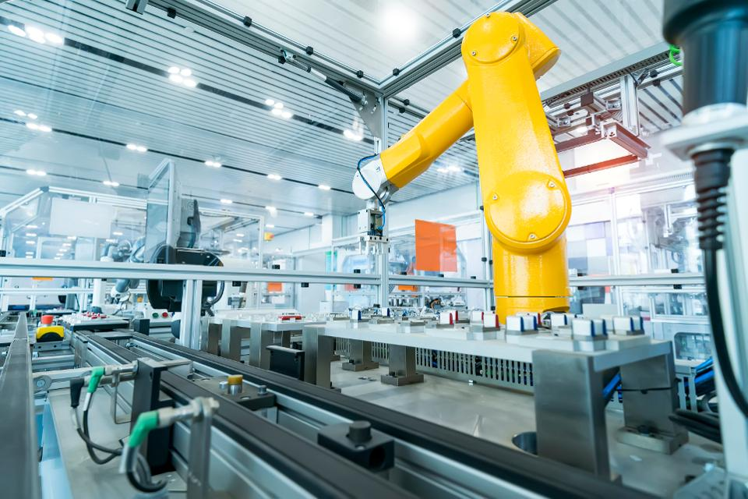







Industries Impacted by AI
Manufacturing |  |  |  | Healthcare
 | Retail |  | Legal Services
Logistics |  |  |  | Advertising
 | BFSI |  | Aviation

Slide 51




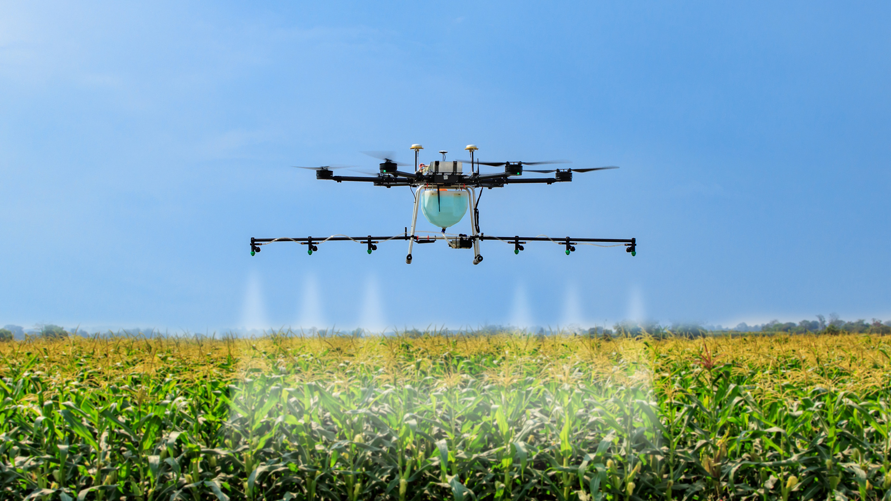
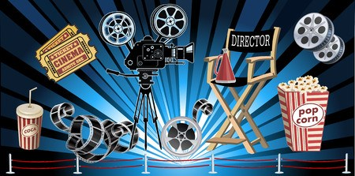


Industries Impacted by AI
Chemicals |  |  |  | Online Shopping
 | Education |  | Sports
Agriculture |  |  |  | Media & Entertainment
 | Software Development & Cybersecurity |  | Call Centers

Slide 52


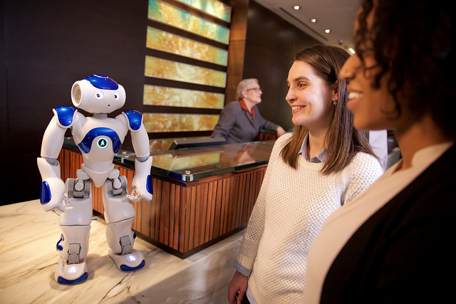

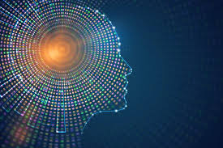
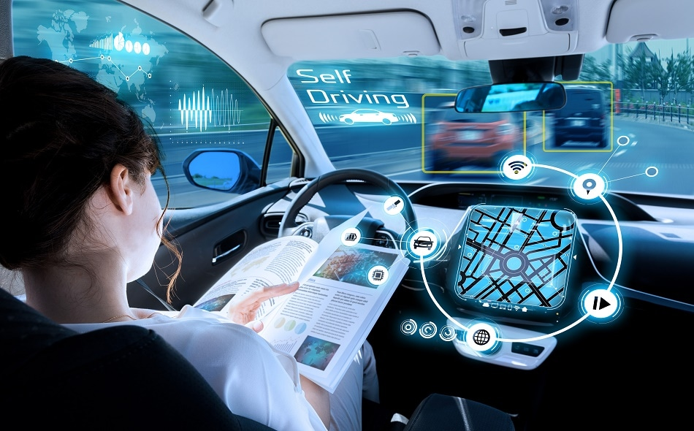

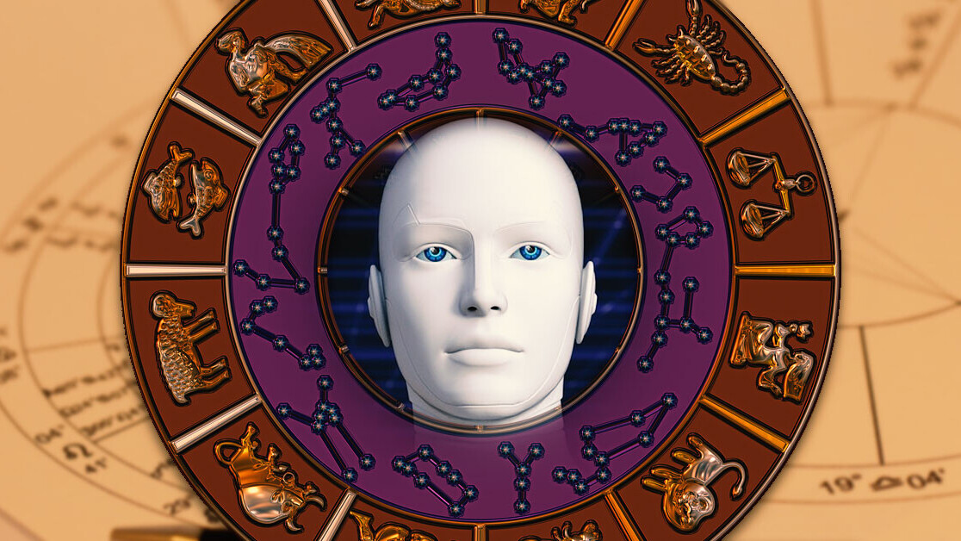
Industries Impacted by AI
Energy, Utilities & Mining |  |  |  | Customer Experience
 | Hospitality |  | Fashion
Intellectual Property |  |  |  | Automotive
 | IT Services Management |  | Fortune Telling

Slide 53
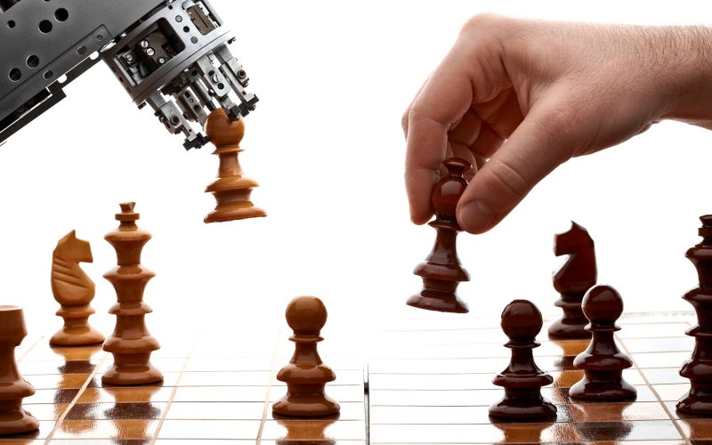
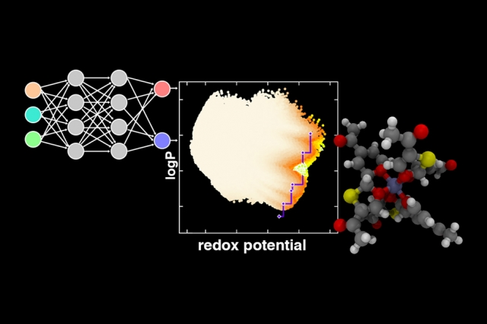




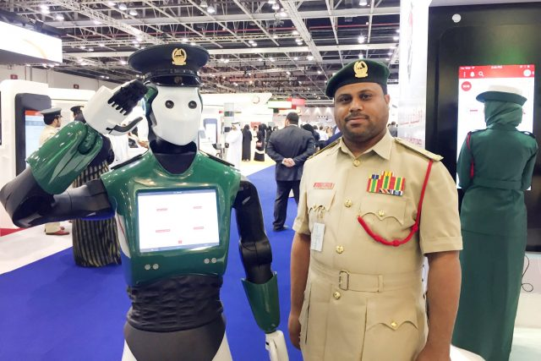

Industries Impacted by AI
Gaming |  |  |  | Materials Discovery
 | Casino |  | Defence
Pharma & Drug Discovery |  |  |  | Music Industry
 | Law Enforcement, Security & Surveillance |  | Job Search & Recruitment

Slide 54
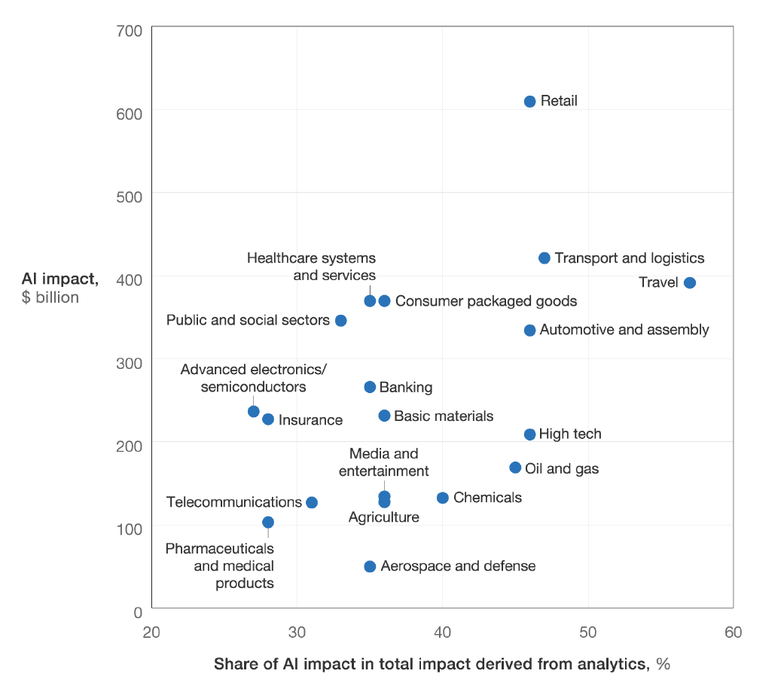
AI Sector-wise Impact
Source: McKinsey
Notes:
https://www.mckinsey.com/featured-insights/artificial-intelligence/the-real-world-potential-and-limitations-of-artificial-intelligence

Slide 55
Artificial Intelligence
AI Use-Cases

Slide 56

AI Applications
“It is tempting to treat everything as if it were a nail if the only tool you have is a hammer”
Abraham Maslow, 1966
Notes:
https://medium.com/intuitionmachine/the-5-kinds-of-problems-where-deep-learning-is-applicable-e48f91186bbd

Slide 57

AI Applications - Motivation
Minimize
Maximize

Slide 58

Modern AI Applications – Three Scenarios for Deep Learning
Definite improvement in performance beyond that provided by other analytics techniques
Traditional analytics techniques are equally good vis-a-vis AI techniques
Greenfield
Majority of use-cases will fall under this scenario
Notes:
https://www.mckinsey.com/featured-insights/artificial-intelligence/notes-from-the-ai-frontier-applications-and-value-of-deep-learning#part1

Slide 59

The Big AI Question
If deep learning is the answer, then what is the question?

Slide 60
Does your business case require
Predicting a continuous numeric value (e.g., gas price in international market)?
Use Supervised Learning - Regression
Credit: AI for People & Business by Alex Castrounis, 2019, O'Reilly

Slide 61
Does your business case require
Predicting a class, category, or label (e.g., good piece or defective)?
Use Supervised Learning - Classification
Credit: AI for People & Business by Alex Castrounis, 2019, O'Reilly

Slide 62
Does your business case require
Creating groupings of similar data to understand the groups profiles (e.g., customer segments)?
Use Unsupervised Learning - Clustering
Credit: AI for People & Business by Alex Castrounis, 2019, O'Reilly

Slide 63
Does your business case require
Identifying highly unusual or dangerous outliers (e.g., network security, fraud, worker without helmets)
Use Unsupervised/Supervised Learning – Anomaly Detection
Credit: AI for People & Business by Alex Castrounis, 2019, O'Reilly

Slide 64
Does your business case require
Personalizing your product, services, features or content for customers?
Use Unsupervised/Supervised Learning –
Recommendations (e.g., media, products, services)
Ranking/scorings
Personalization (e.g., content, offers, messaging, interactions, layout)
Credit: AI for People & Business by Alex Castrounis, 2019, O'Reilly

Slide 65
Does your business case require to
Detect, label, and identify specific spatial, temporal, or spaciotemporal patterns, say in audio or video?
Use Unsupervised/Supervised Learning –
Recognition (image, audio, speech, video, handwriting, text)
Computer vision (e.g., detection: motion, gesture, expression, sentiment)
Natural language processing (NLP)
Credit: AI for People & Business by Alex Castrounis, 2019, O'Reilly

Slide 66
Does your business case require
AI to self-learn in order to optimize a process over time (e.g., game playing, automation, intelligent guessing)?
Use Reinforcement Learning
Credit: AI for People & Business by Alex Castrounis, 2019, O'Reilly

Slide 67
Does your business case require
Allow people and processes to find highly relevant information quickly and easily
(e.g., articles, images, videos, documents, URL, application link)?
Use Classical/Symbolic AI
Search (text, speech, visual)
Use Supervised Learning
Ranking/scoring
Credit: AI for People & Business by Alex Castrounis, 2019, O'Reilly

Slide 68
Does your business case require
Creating a personal or virtual assistant, chatbot, or language-driven agent (e.g., Amazon Alexa, Apple Siri or Speech-Enabled Chatbot) for question-answering?
Use Natural Language Processing
and Natural Language Understanding (Azure LUIS)
Credit: AI for People & Business by Alex Castrounis, 2019, O'Reilly

Slide 69
Does your business case require
To create better forecasts?
Use Deep Learning Recurrent Neural Network
LSTM
Credit: AI for People & Business by Alex Castrounis, 2019, O'Reilly

Slide 70
Does your business case require
Generating data from one kind to another (e.g., text, audio, image, video, speech)?
Use Generative AI (including natural language generation, NLG)
Credit: AI for People & Business by Alex Castrounis, 2019, O'Reilly

Slide 71
Classification
Continuous Estimation
Clustering
Optimization
Machine Vision
AI Application Areas
Anomaly Detection
Ranking
Recommendation
Data Generation
Natural Language

Slide 72

Notable AI Use-Cases

Slide 73
Select Real AI Use-Cases
S.N. | Company | Published Use-Case
1 | Google | Maximizing The Potential Of Artificial Intelligence Artificial Intelligence Personal Assistants Language Translation Self-Driving Cars Captioning Millions Of Videos Diagnosing Disease Google Brain Deep Mind
Credit: Artificial Intelligence in Practice by Bernard Marr & Matt Ward, 2019, Wiley

Slide 74
Select Real AI Use-Cases
S.N. | Company | Published Use-Case
2 | The Walt Disney Company | Using Artificial Intelligence To Make Magical Memories In 2013, Disney introduced its MagicBand wristbands, which are issued to every visitor and let them book rides and attractions, access their hotel rooms, order meals at the park's restaurants and pay for purchases in gift shops. They also give Disney detailed information about what each visitor is doing at every point in the day. This lets them offer personalized experiences . It also gives park planners detailed aggregated datasets about overall visitor movements. This means that planners can repurpose spots that fail to attract footfall to ease congestion around the top attractions and hotspots that cause bottlenecks throughout the day. Because data is analyzed in real time, response can be real time too – for example, staging an impromptu character parade to draw crowds from a heavily congested area to a quieter one.
Credit: Artificial Intelligence in Practice by Bernard Marr & Matt Ward, 2019, Wiley

Slide 75
Select Real AI Use-Cases
S.N. | Company | Published Use-Case
3 | BMW | Using Artificial Intelligence To Build And Drive The Cars Of Tomorrow Back in 2016, a partnership with IBM saw four BMW i8 vehicles connected to the IBM Watson cognitive computing platform through their IBM cloud service. The idea was that the car could learn how to improve its understanding of driver behavior and then adapt its system to suit personal preferences. By uploading all the data it gathers to the cloud, the system is able to build a vast database of user behaviors, and then use machine learning to anticipate the needs and preferences of other drivers.
Credit: Artificial Intelligence in Practice by Bernard Marr & Matt Ward, 2019, Wiley

Slide 76

Sophia The Robot Video

Slide 77



Bhagirath Kumar Lader
aiforworld7@gmail.com
https://www.linkedin.com/in/BhagirathL
https://twitter.com/BhagirathL
BhagirathL
BhagirathL

